Slide 1
IUL- Gym system
Done by :Ali Chaaban 67191 Ahmad Tantouri 73667 Presented to: Engineer Ali Abo Melhem

Slide 2
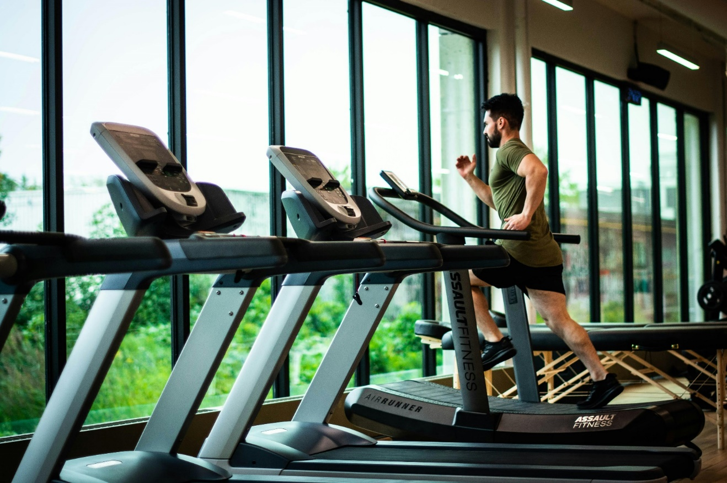
Outline
Introduction
Implementation
Conclusion

Slide 3
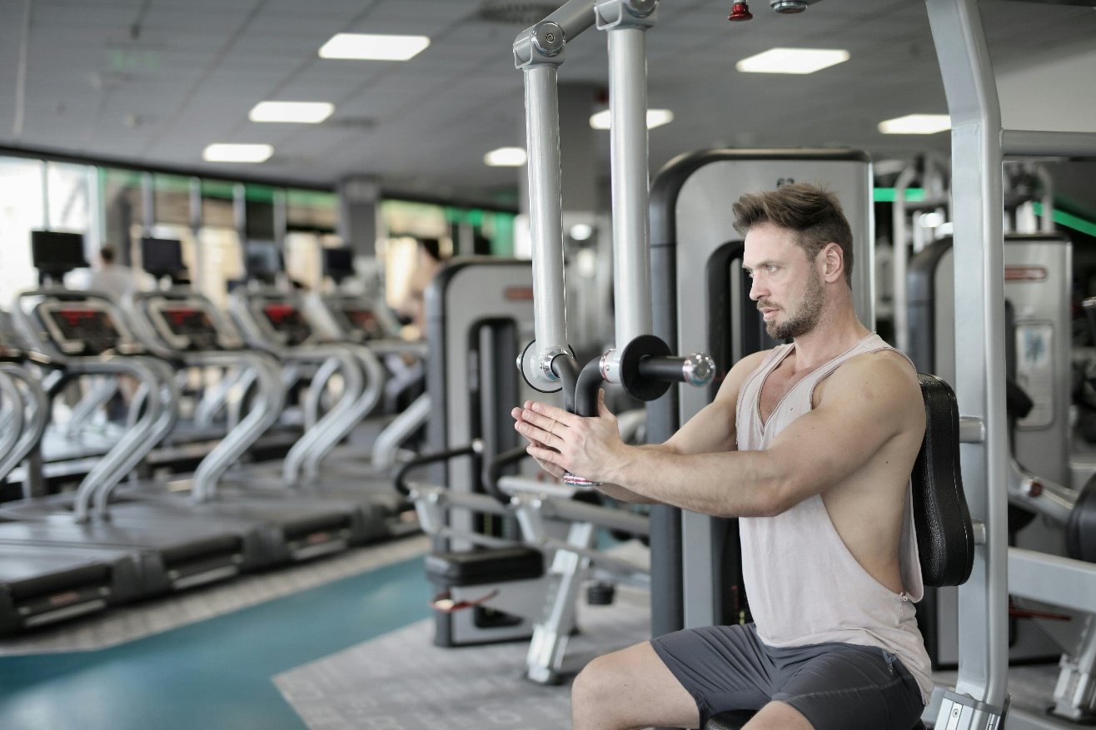
Introduction
In our Gym, the admin enters the trainee, the trainer follow him by setting a daily exercise program for him. We also follow up on his daily meals through dietitians to get the best results that trainee wants.

Slide 4
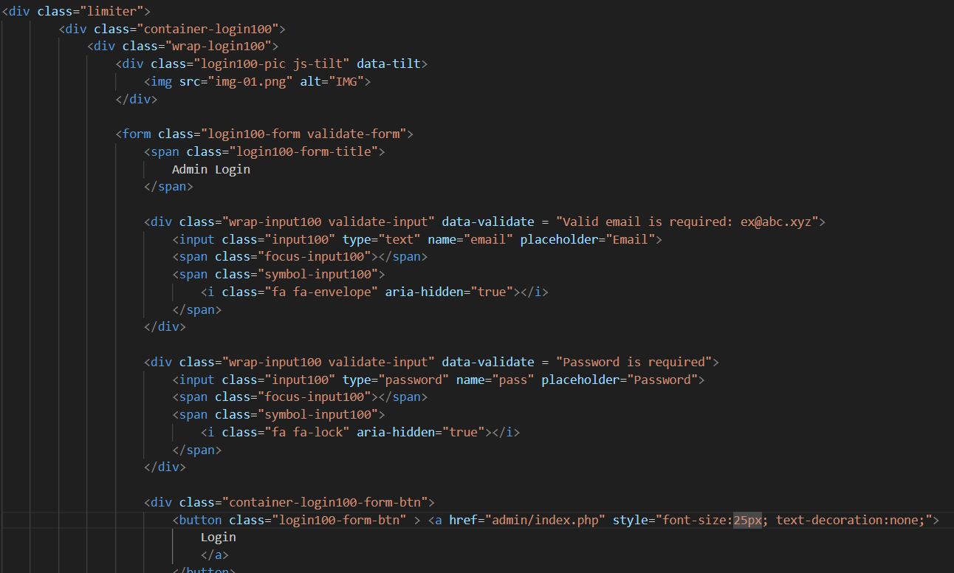
Implementation.

Slide 5
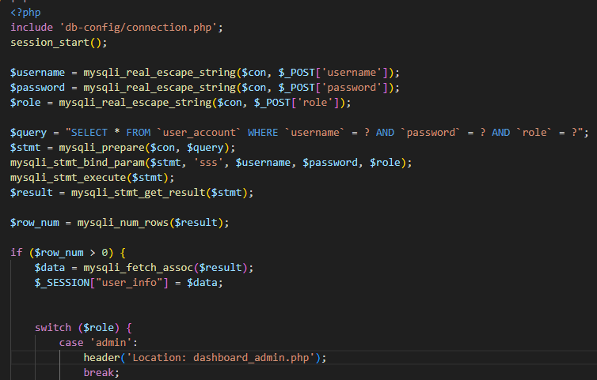
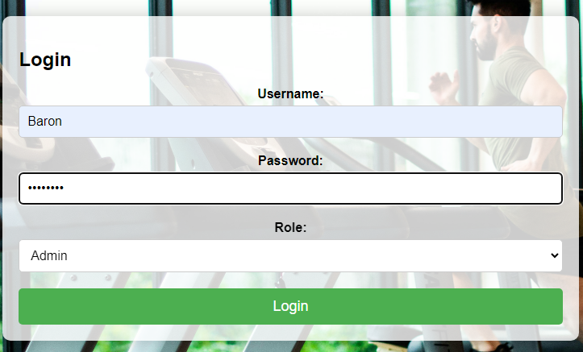
Login page
Admin login

Slide 6
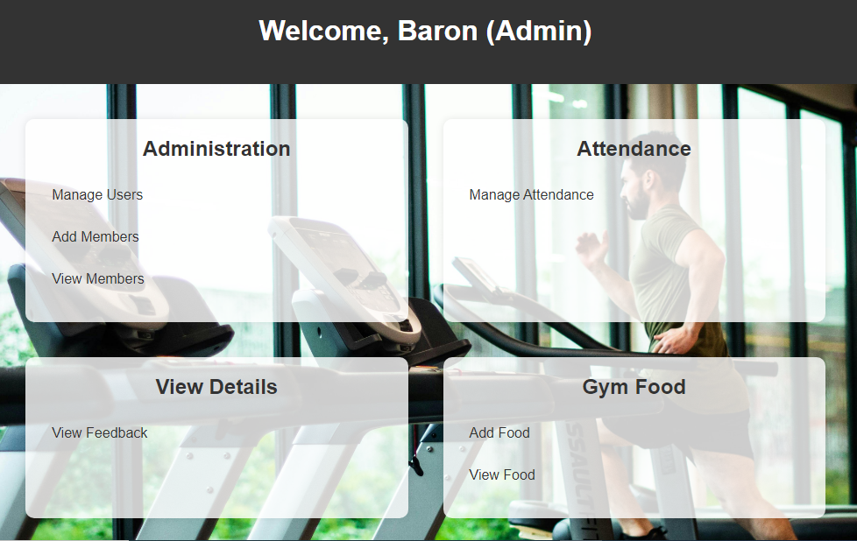
Admin dashboard

Slide 7
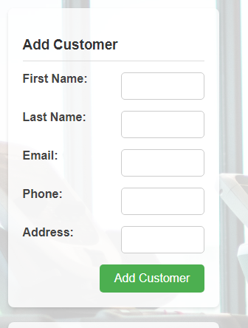
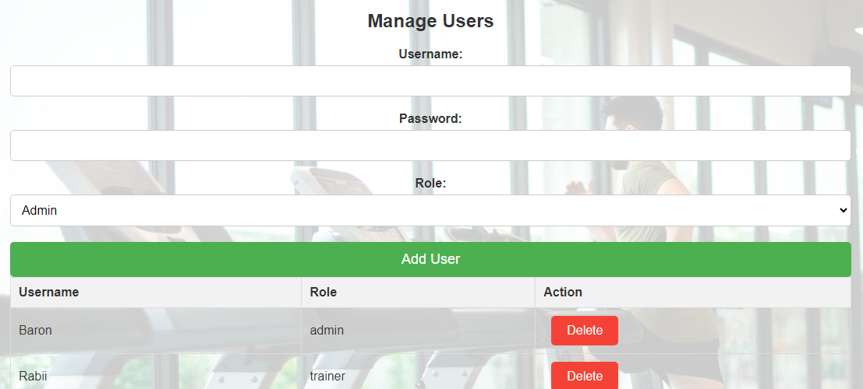
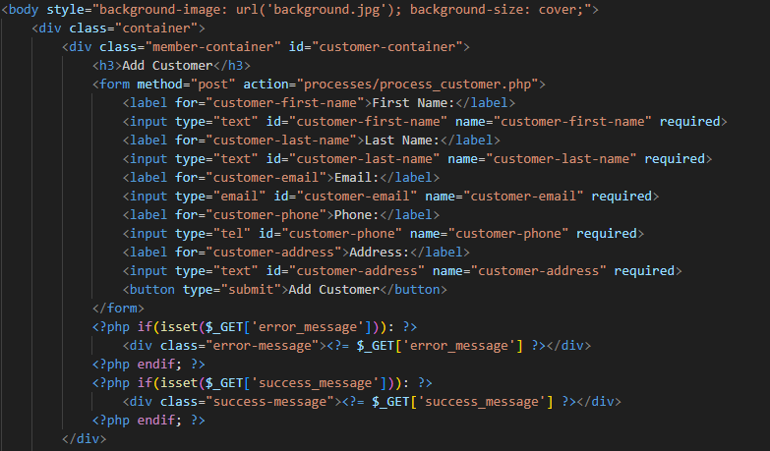
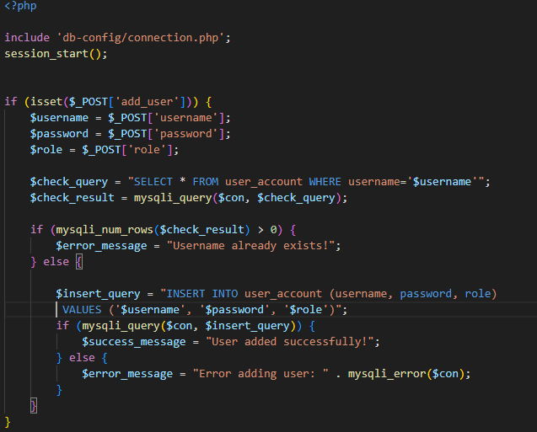

Slide 8
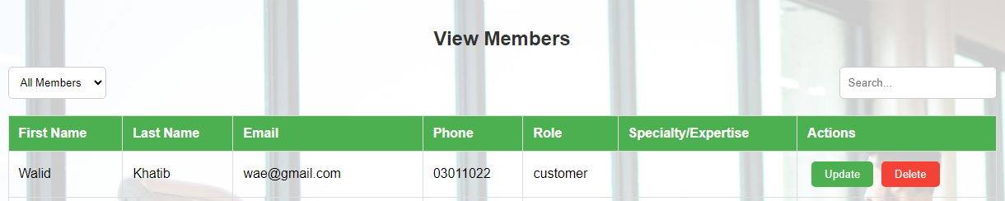

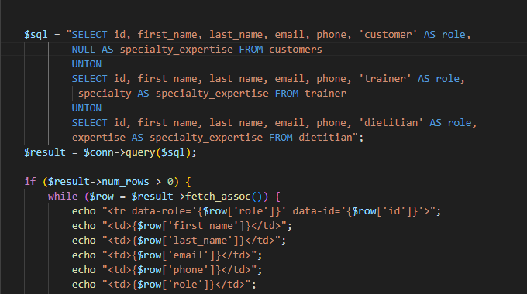


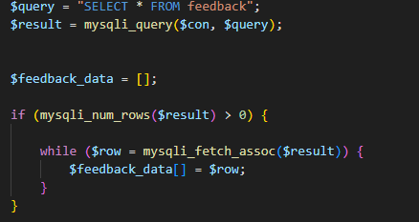

Slide 9


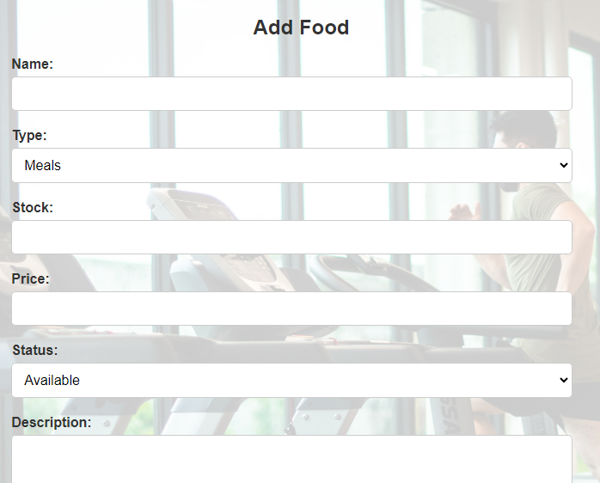
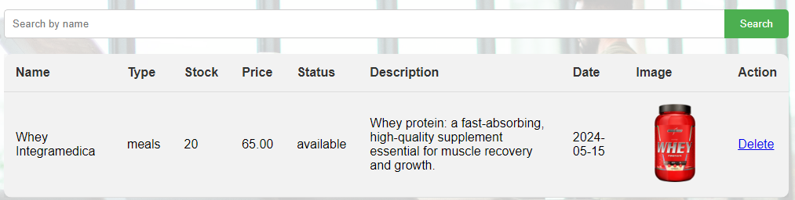
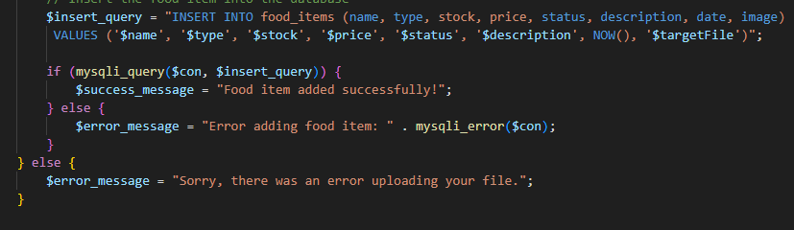
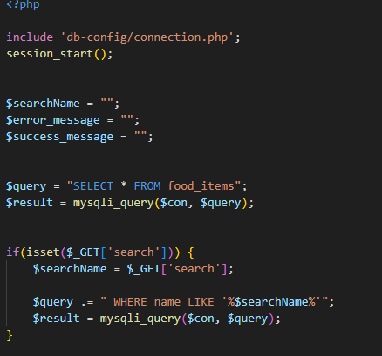

Slide 10
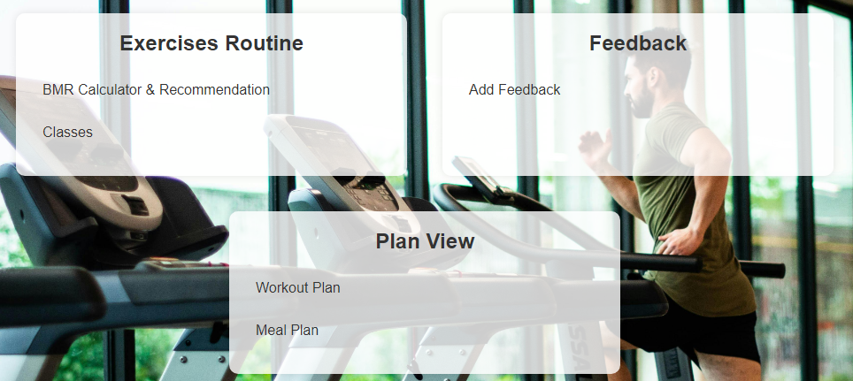
Customer dashboard

Slide 11
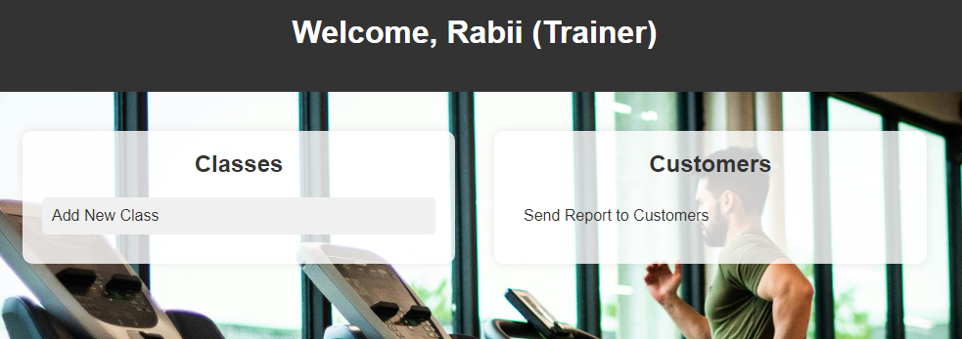
Trainer dashboard

Slide 12
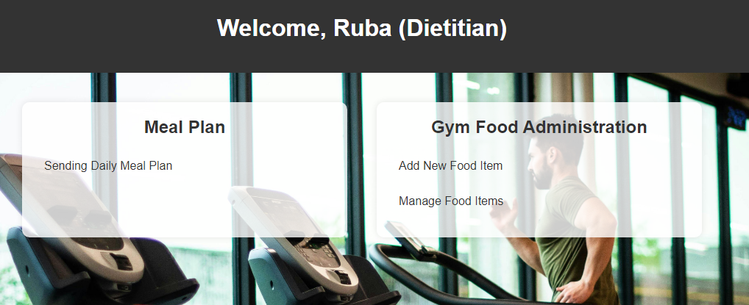
Dietitian dashboard

Slide 13
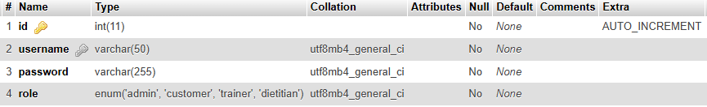

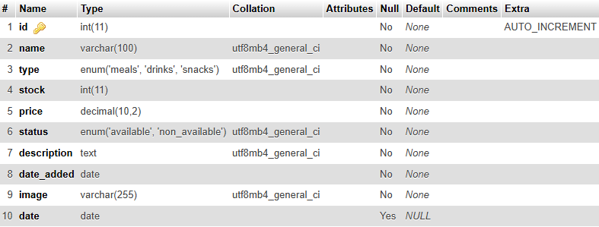


Slide 14
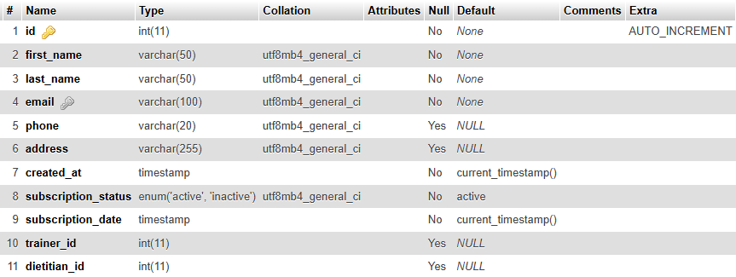

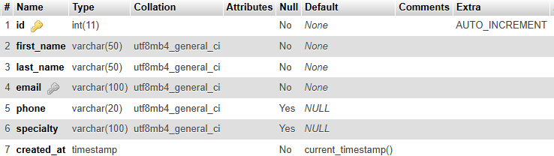

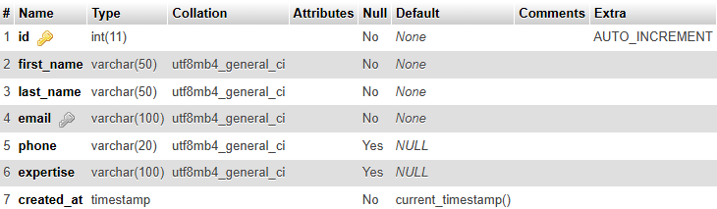


Slide 15
Conclusion:
Going to the gym has many benefits. It helps make your body stronger and healthier by improving your heart and muscles, going to the gym is good for your mind too. It can reduce stress, anxiety, and sadness, and make you feel better about yourself.

Slide 16

Ali chaaban 67191 ahmad tantouri 73667

